Slide 1

MARCH
SUNDAY | MONDAY | MATH | WEDNESDAY | THURSDAY | FRIDAY | SATURDAY
 |  |  |  |  | ONE 1 | TWO 2
THREE 3 | FOUR 4 | FIVE 5 | SIX 6 | SEVEN 7 | EIGHT 8 MINING DAY | NINE 9
TEN 10 | ELEVEN 11 | TWELVE 12 | THIRTEEN 13 | FOURTEEN 14 | FIFTEEN 15 | SIXTEEN 16
SEVENTEEN 17 | EIGHTEEN 18 | NINETEEN 19 | TWENTY 20 | TWENTY ONE 21 | TWENTY TWO 22 | TWENTY THREE 23 DAY OF THE ARRIERO
TWENTY FOUR 24 | TWENTY-FIVE 25 | TWENTY SIX 26 | TWENTY SEVEN 27 | TWENTY EIGHT 28 | TWENTY NINE 29 | THIRTY 30
THIRTY-ONE 31
2 0 1 9

Slide 2
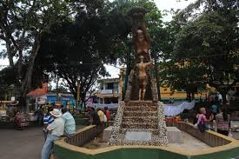
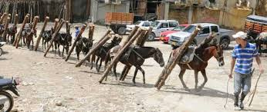
SEGOVIA - ANTIOQUIA
Town square, meeting place, cultural events, concerts, gastronomic show, mining contest.
The mule or mule is a sterile hybrid animal that results from the crossing between a mare and a donkey or donkey, used in tasks that require strength or resistance, can live up to 23 years, have a weight of 400 to 450 kilos.
Used in the northeast region of Antioquia in the mining areas to load wood, tools, supplies and other materials used in gold mining.
8
23

Slide 3

APRIL
SUNDAY | MONDAY | MATH | WEDNESDAY | THURSDAY | FRIDAY | SATURDAY
 | ONE 1 | TWO 2 | THREE 3 | FOUR 4 | FIVE 5 | SIX 6
SEVEN 7 WATER DAY | EIGHT 8 | NINE 9 | TEN 10 | ELEVEN 11 | TWELVE 12 | THIRTEEN 13
FOURTEEN 14 | FIFTEEN 15 | SIXTEEN 16 | SEVENTEEN 17 | EIGHTEEN 18 | NINETEEN 19 DAY OF THE FOREST | TWENTY 20
TWENTY ONE 21 | TWENTY TWO 22 | TWENTY THREE 23 | TWENTY FOUR 24 | TWENTY-FIVE 25 | TWENTY SIX 26 | TWENTY SEVEN 27
TWENTY EIGHT 28 | TWENTY NINE 29 | THIRTY 30
2 0 1 9

Slide 4
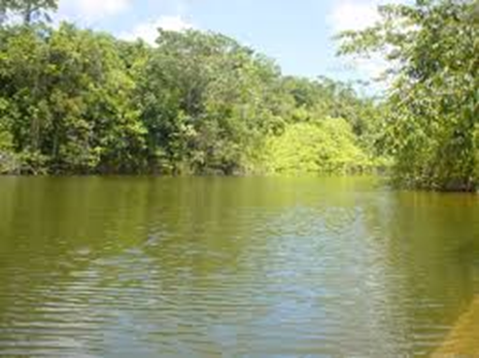
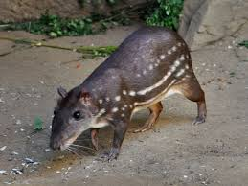
SEGOVIA - ANTIOQUIA
Natural natural bath of natural water, you can make ecological walks, tourist place of Segovia. There are several restaurants that offer typical dishes of Antioquia cuisine.
The common paca, lapa or tepezcuintle is a species of hystricomorph rodent of the family Cuniculidae that lives in the vicinity of the water courses of the tropical forests, measures 80 centimeters, weighs 15 kilos, lives up to 10 years, a species very desired by its fine meat.
7
19

